Slide 1




Dermal Scan
AI Facial Skin Aging Detection App
Presented by
D.Upendar

Slide 2
Identify aging features and provide accurate predictions.
Agenda
Project Statement
Objectives
Methodology
A technical deep dive into the data preprocessing, model architecture, and the end-to-end analysis pipeline from image upload to result.
An overview of the project's goal: to build an AI system for detecting facial aging signs using MobileNetV2 and a Streamlit web app.
Identify aging features and provide accurate predictions.including model training, UI development, and the key deliverables of the project.

Slide 3
Annotated outputs, accuracy, and performance evaluation.
Future Enhancements
Results
Conclusion
Annotated outputs, accuracy, and performance evaluation.
A summary of the project's achievements and the key learnings from the development process.
A discussion of the project's potential roadmap, including plans for dataset expansion and mobile integration.

Slide 4
Project Statement
Project Statement
Objective: Develop a deep learning-based system to detect and classify facial aging signs from user-uploaded images.
Objective: Develop a deep learning-based system to detect and classify facial aging signs from user-uploaded images.
Core Technology:
Model: MobileNetV2 for high-efficiency image classification.
Application: An interactive web UI built with Streamlit.
Backend: Python with OpenCV for image processing and analysis.

Slide 5

Objectives & Outcomes
Key Objectives:
Develop a Detection Pipeline: Build an end-to-end system to process an image, detect a face using Haar Cascades, and prepare it for model inference.
Train the Classification Model: Fine-tune a pre-trained MobileNetV2 model to accurately classify six categories of skin conditions, including acne, wrinkles, and dark spots.
Build an Interactive UI: Create a user-friendly web interface with Streamlit that allows users to easily upload an image and view the results.
Provide Detailed Results: Display the classification result with a confidence score and an estimated age, annotated directly onto the output image.

Slide 6

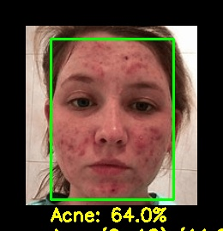
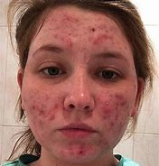
`````
Project Outcomes
A functional web application that delivers real-time facial analysis with a processing time of under 5 seconds.
A highly accurate classification model with a validation accuracy of 99.75%.
Features to download the annotated image and a CSV log of the prediction details.
Example-1

Slide 7
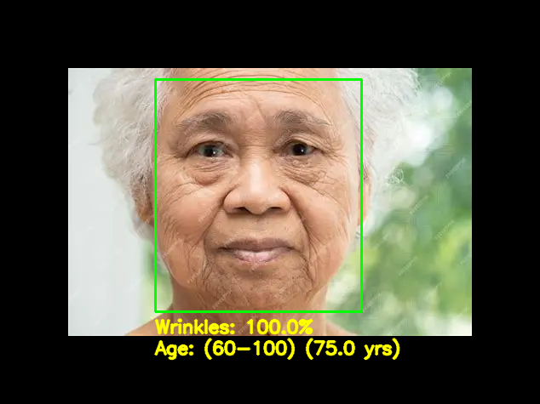
Example -2

Slide 8
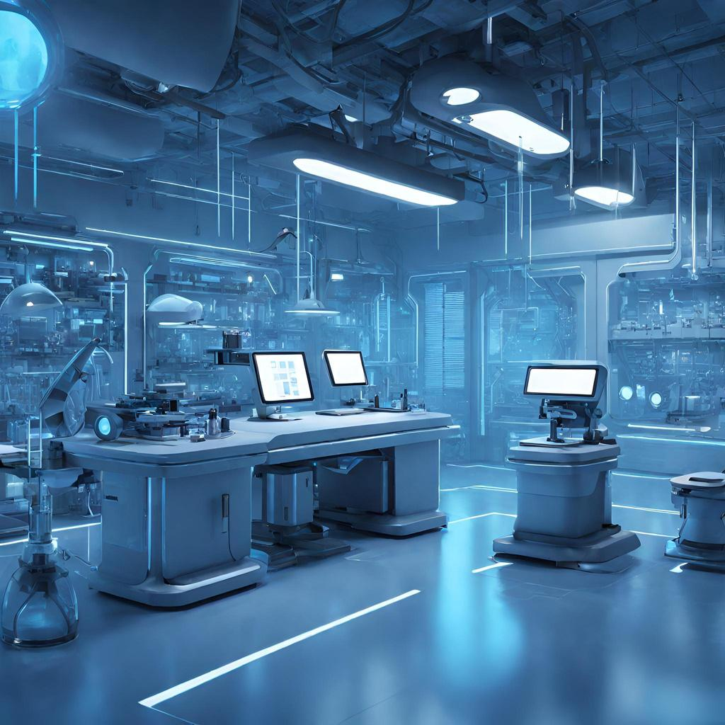
Tech Stack
Python Version
python==3.10
Core
numpy>=1.23.0
pandas>=1.5.0
Machine Learning / Deep Learning
tensorflow>=2.10.0
scikit-learn>=1.2.0
Computer Vision
opencv-python>=4.7.0
Web UI
streamlit>=1.24.0
Visualization
matplotlib>=3.7.0
Image Ops:OpenCV, NumPy, Haarcascade

Slide 9
Dataset & Preprocessing
Collected a diverse facial image dataset from Kaggle, including categories such as wrinkles, dark spots, puffy eyes, scars, and clear skin.
Ensured balanced distribution and quality samples for effective model training and evaluation.
Total Images: 21,510 across 6 classes
Classes: Acne, Clear Face, Dark Spots, Puffy Eyes, Scars, Wrinkles
All images resized to 224×224 pixels for model input

Slide 10
Data Preprocessing
The goal of this pipeline was to transform the raw image collection into a normalized, expanded, and memory-efficient dataset ready for training a MobileNetV2 model.
Resizing → All images are resized to a uniform size of 224 × 224 pixels.
Normalization → Pixel values are scaled between 0 and 1 (rescale=1./255).
Folder Structure → Images are organized into class-wise folders for training.
Consistency → Original resized images are also saved to the processed dataset.

Slide 11
Data Augmentation
To improve model generalization and prevent overfitting, each image is augmented using:
Rotation (±25°) – helps learn orientation invariance.
Width & Height Shift (±15%) – makes the model robust to positional changes.
Shearing (10%) – introduces geometric transformations.
Zoom (±20%) – mimics different camera distances.
Augmentation Strategy: 4 augmented versions were generated for every original image (augment_per_image = 4). The transformations included:Geometric: Random rotation (±25∘), shifts (±15%), shear, zoom, and horizontal flipping.
Brightness Adjustment (0.8–1.2) – simulates lighting variations.
Fill Mode = Nearest – fills missing pixels after transformations.

Slide 12
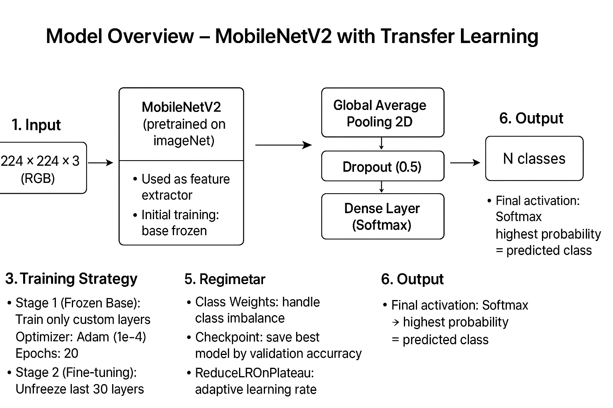
Model Overview
We employed a Transfer Learning approach using the MobileNetV2 architecture, fine-tuning it in two distinct stages to achieve optimal performance on the skin condition classification task.

Slide 13
Training Strategy
Stage 1 – Frozen Base Training
Base MobileNetV2 kept frozen (pretrained ImageNet features).
Only the custom classifier head is trained.
LR = 1e-4, Epochs = 20, Batch Size = 32.
Purpose: Quickly learn how to map general features → skin condition classes.
Stage 2 – Fine-Tuning
Unfreeze the last 30 layers of MobileNetV2.
Retrain both base + classifier with a lower LR (1e-5).
Epochs = 50, Batch Size = 32.
Purpose: Adapt pretrained features to domain-specific patterns (wrinkles, scars, acne, etc.).
Optimizer: Adam
Loss Function: Categorical Crossentropy (multi-class)
Mtric: Accuracy

Slide 14
Two-Stage Fine-Tuning Process
Stage Goal Layers Trained Learning
Rate
Epocs
Stage 1:
Future
Extraction
Quickly train
the new
classification
head.
MobileNetV2 base
was frozen. Only the
custm Global Average
Pooling,Doropout,
and Dense layers
were trained.
1×10−4
(Initial)
20 (with early stopping)
Stage 2:
Fine-Tuning
Tune the base
network to the
specific dermal
feature set.
The custom head PLUS
the last 30 layers of
the MobileNetV2 base
were unfrozen
and trained.
1×10−5
(10x smaller)
50 (with early stopping)

Slide 15
Training Safeguards(Callbacks)
We employed robust callbacks to manage the training process dynamically and ensure we captured the best possible model performance:
ModelCheckpoint:
Saved weights only when validation accuracy improved
Ensured we captured the best-performing model
Final output: mobilenetv2_best_model.h5
ReduceLROnPlateau:
Monitored validation loss
Reduced learning rate by 50% if no improvement for 3 epochs
Helped the model escape local minima
EarlyStopping:
Stopped training if validation loss did not improve for 5 epochs
Restored best weights to prevent overfitting and save time

Slide 16
Accuracy
2
Overall Performance Metrics:
Interpretation
Metric
Result
The model correctly classified 99.75% of the skin condition images in the test set.
Validation Accuracy
99.75%
0.0068
Loss
An extremely low loss value, indicating high confidence in the correct predictions.

Slide 17
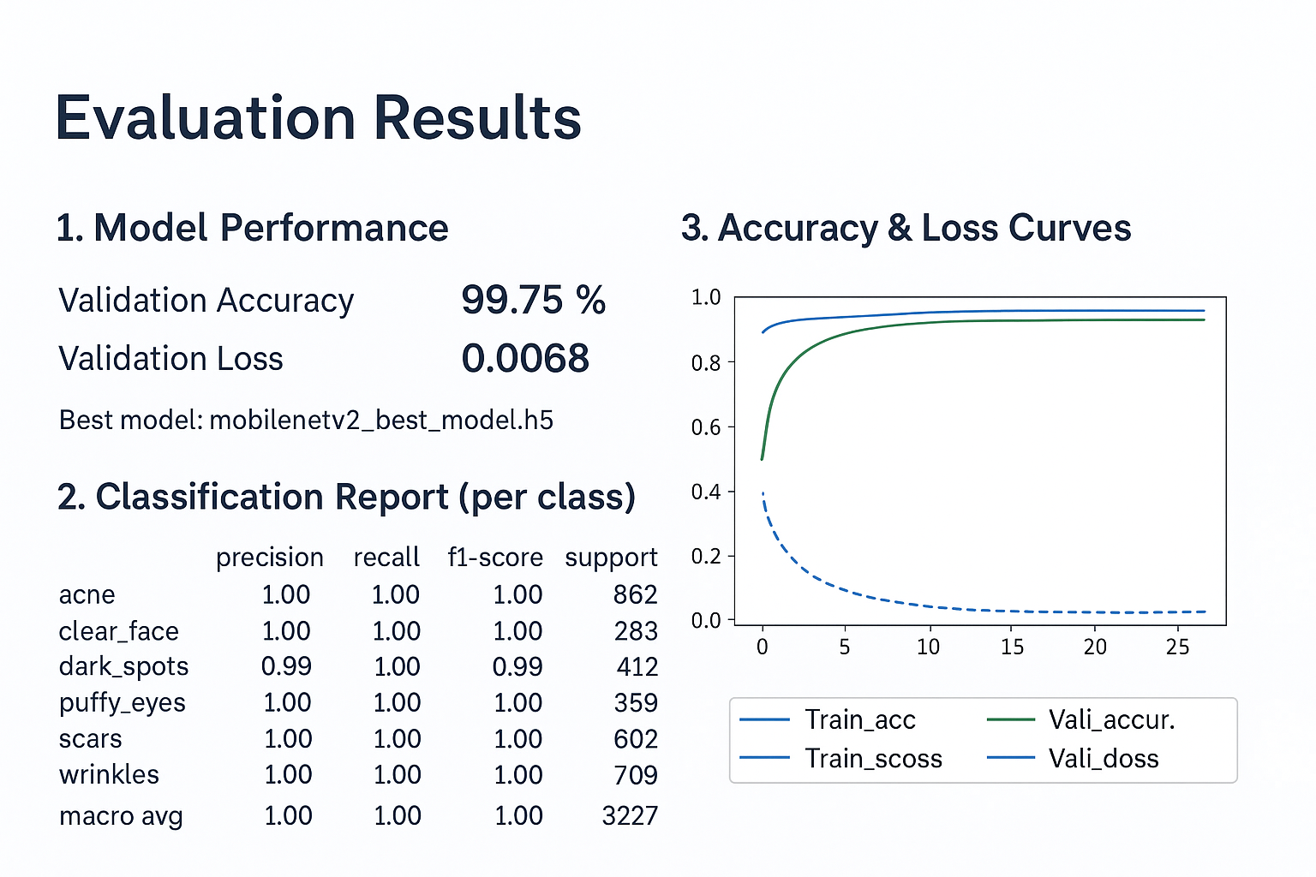
EvaluationResults

Slide 18
Prediction Pipeline
Here are the models explicitly included in the pipeline.
Skin Condition Classification Model
Model Name: MobileNetV2 (Pre-trained and Fine-tuned)
Purpose: Classifies input images into one of six skin conditions.
File (Weights): mobilenetv2_best_model.h5
File (Architecture): The Python Keras code defines the architecture.
Age Prediction Model
This model uses the Caffe framework, suggesting it's likely a pre-existing model for general age estimation.
Model Type: Caffe Model (Deep Learning)
Model Weights: age_net.caffemodel
Model Architecture: age_deploy.prototxt
Purpose: To estimate the age of the detected face.

Slide 19
Face Detection Model (External Component)
This component is a separate, highly efficient deep learning face detector (often SSD or similar), used as an alternative or complement to the OpenCV Haar Cascades for more robust face localization.
Model Type: Deep Learning Face Detector (likely Single Shot Detector - SSD)
Model Weights: opencv_face_detector_uint8.pb (TensorFlow/Protobuf file)
Model Architecture: opencv_face_detector.pbtxt (Protobuf text file)
Purpose: Accurately detect the location of a face in an image.

Slide 20
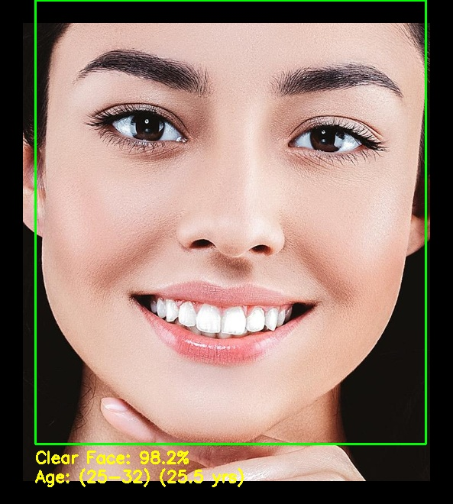
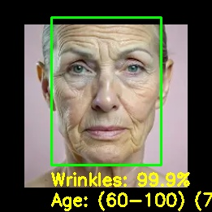
Prediction Images

Slide 21
Deployment: DermalScan Web Application (Streamlit)
User Input: The interface supports drag-and-drop or file browsing for image submission.
File Type Limit: The app accepts standard image formats like JPG, JP(E)G, and PNG.
File Size Limit: The maximum file size is restricted to 200MB.
Visual Output: The primary output is the visualization of aging signs with annotated bounding boxes and confidence scores. This is a crucial feature, showing where the model detected the condition on the face.

Slide 22
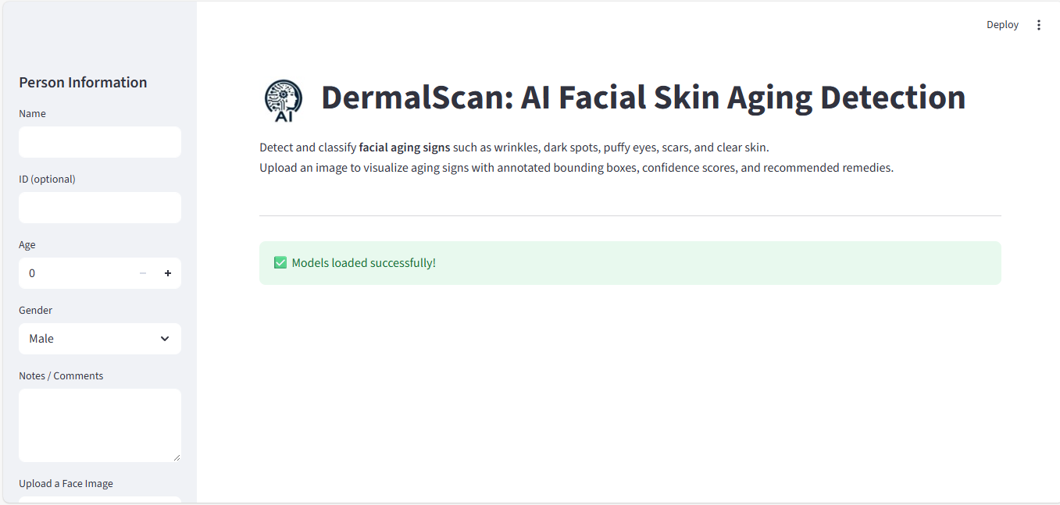
Streamlit UI

Slide 23
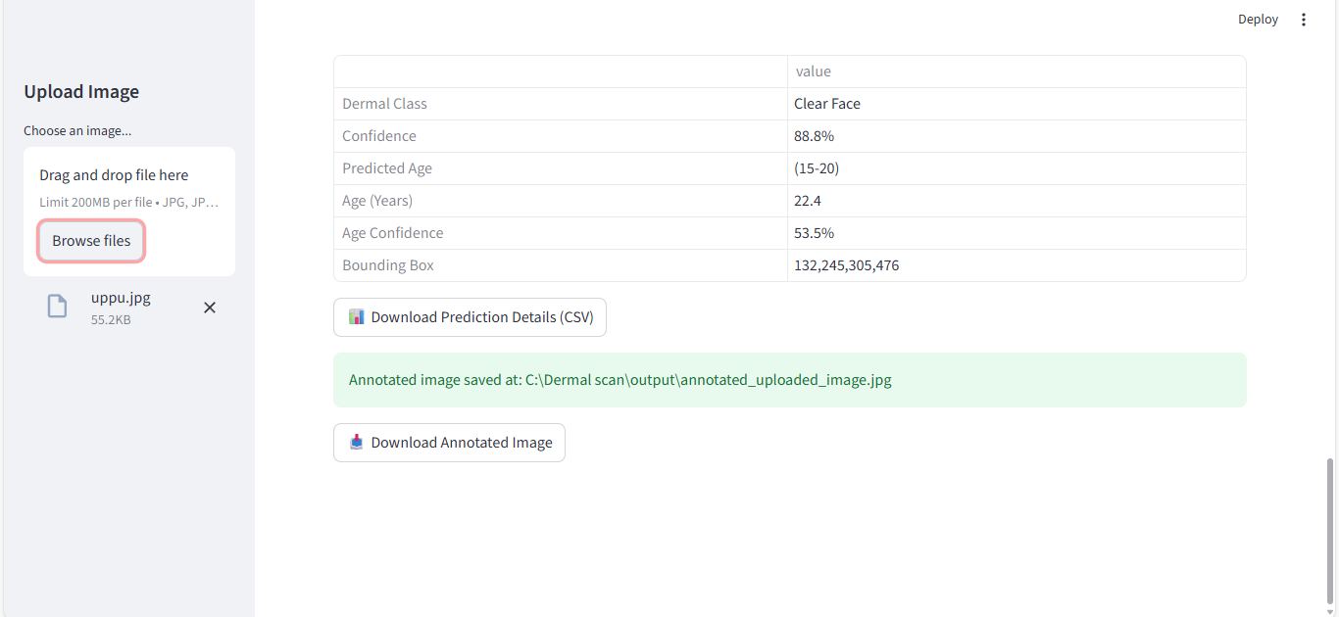
Prediction Details

Slide 24
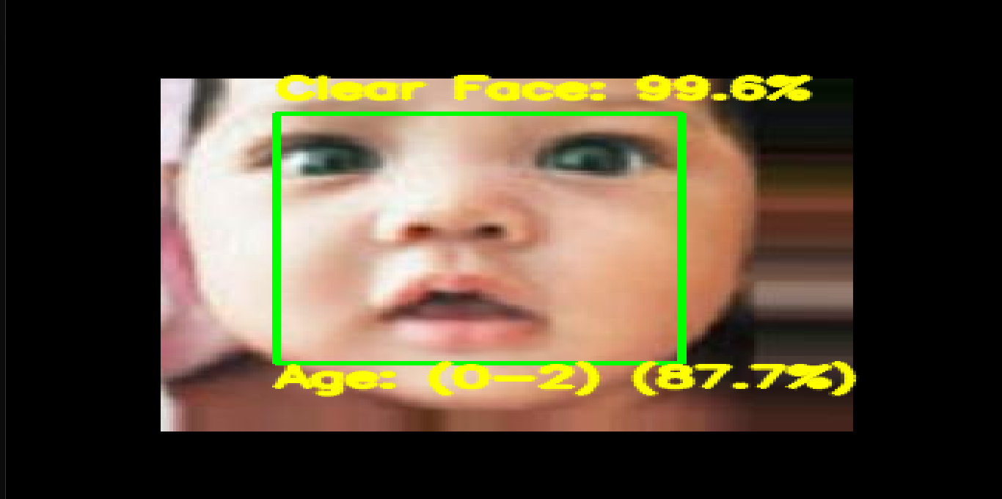
Annotated Image
3

Slide 25
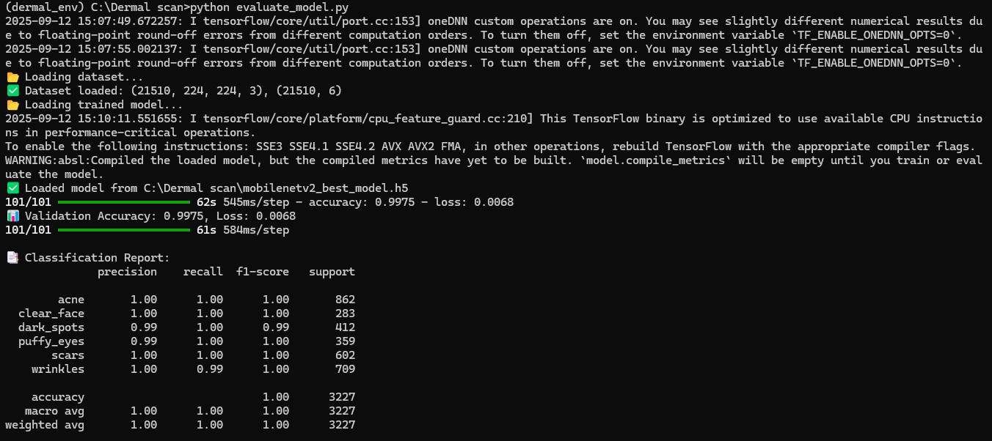
Evaluation Metrices

Slide 26
Challenges Faced
Dataset Collection & Preprocessing
Limited availability of high-quality, balanced skin condition images.
Required augmentation (rotation, zoom, brightness, etc.) to increase dataset diversity.
Model Training
Risk of overfitting due to small dataset.
Solved by transfer learning (MobileNetV2), dropout, and callbacks (EarlyStopping, ReduceLROnPlateau, ModelCheckpoint). UI & Integration

Slide 27
Initial Attempt – EfficientNetB0
Started with EfficientNetB0 as the base model.
Faced longer training times and higher computational demand.
Although accuracy was good, it was too heavy for real-time deployment.
2. Transition to MobileNetV2
Switched to MobileNetV2, a more lightweight & efficient model.
Achieved faster training, lower inference time, and reduced memory usage.
Maintained high accuracy (~99%) while being deployment-friendly.

Slide 28

Future Enhancements
• Larger dataset
• Multi-class aging signs
• Mobile app integration
• Real-time detection

Slide 29
Key Use Cases for the DermalScan Application
🧑‍⚕️ Clinical & Aesthetic Use
Pre-screening & Triage: Provides dermatologists with a quantified skin report before consultation.
reatment Planning: Uses bounding boxes and percentage scores for planning laser treatments or fillers.
Measurable Results: Offers verifiable proof of treatment success (before/after data).
Consumer & Skincare
Personalized Recommendations: Identifies precise skin needs (Wrinkles, Dark Spots, Acne) for product matching.
Routine Tracking: Users can monitor the quantifiable effectiveness of their skincare routine over time.
Age-Based Validation: Uses precise age estimation to deliver highly targeted advice.
Objective Efficacy Testing: Measures the success of clinical tria
ls by tracking reduction in aging signs (e.g., from 85% wrinkles to 60%).
Data-Driven R&D: Analyzes large datasets to identify market trends and target product development.
Quantifiable Benchmarks: Establishes objective benchmarks for product claims.

Slide 30
Conclusion
The DermalScan project successfully validated a highly accurate deep learning system for classifying facial skin conditions, confirming the viability of using efficient models
By employing a Two-Stage Transfer Learning strategy with MobileNetV2, and utilizing robust data handling through Data Augmentation and Balanced Class Weighting, we achieved exceptional performance: 99.75% Validation Accuracy and a perfect 1.00 F1-Score.
The final comprehensive system integrates a classifier, a face detector, and an age model, all deployed as an interactive Streamlit web application. This provides a practical, efficient, and highly accurate tool ready for non-invasive skin health screening.

Slide 31
Thank you!
Thank you for your time.
D.Upendar
upendarduggineni24@gmail.com
GitHub:https://github.com/SpringBoardMentor0781j/Dermal_Scan_Project_2025.git

